Slide 1
Framingham Heart Study
Anna Puk, Jaya Deonandan | Prof. MacDonald | SCS 3253 – Machine Learning | University of Toronto

Slide 2
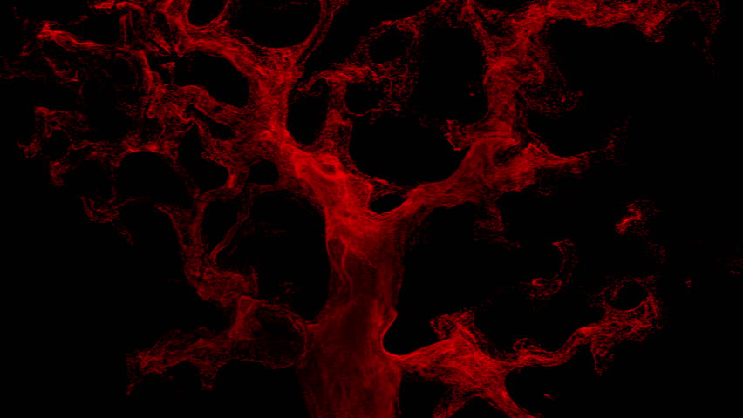
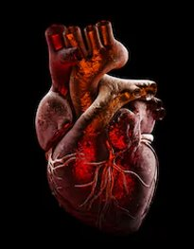
Predicting a Ten-Year Risk of Developing Coronary Heart Disease:
Problem: What risks and causes contribute to developing coronary heart disease, and are they good
predictors in determining whether someone will develop this health condition?
Notes:
We all know how important health is in this day and age. But what factors go into health and truly make an impact? Can you predit whether someone will develop a condition or disease based on their current lifestyle and their current state of health? This is what our project attempts to explore. Specifically, the problem we are examining is what risks and health conditions contribute to developing coronary heart disease, and whether they are good predictors in determining whether someone will develop this condition. And the question we aim to answer is whether or not we can predict whether someone will develop coronary heart disease over a ten year span given their current health and lifestyle. If so, this could have implications for health professionals to focus more on prevantative treatments to avoid costs of treating or managing coronary heart disease and its symptoms, potentially saving money and burden on the health care system over the long term.

Slide 3
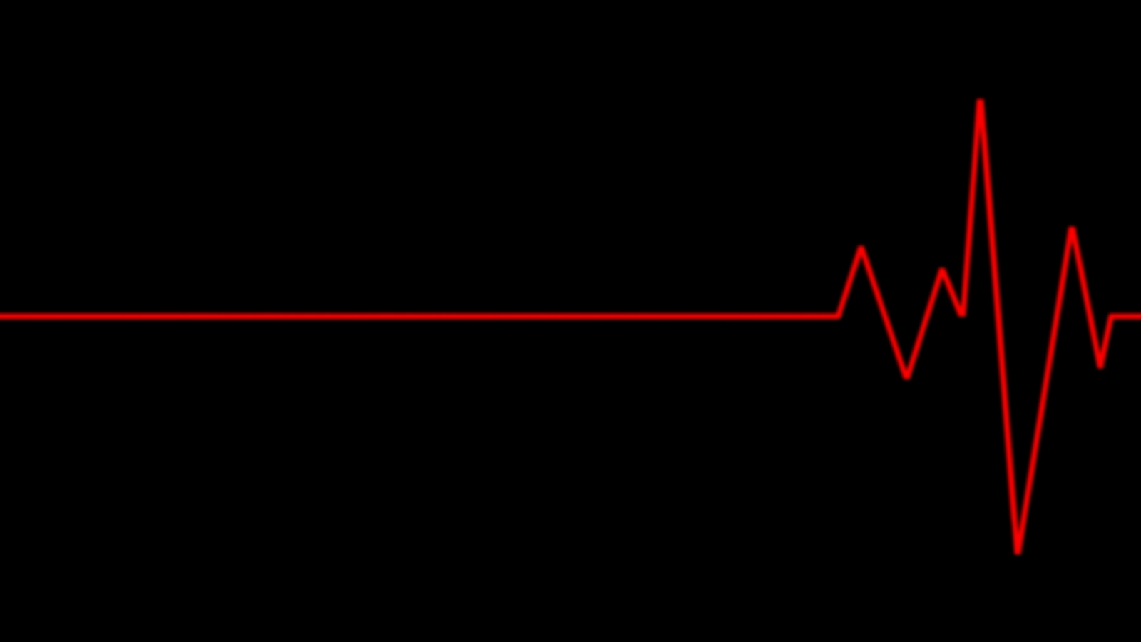
Project Overview
The goal of this project is to examine epidemiological data, specifically potential causes and risk factors that contribute to developing coronary heart disease throughout a ten-year span
Within this project, the following factors are examined:
Sex
Age
Education
Whether someone currently smokes
Number of cigarettes smoked per day
Whether or not they are taking blood pressure medication
Presence of a stroke
Presence of diabetes
Glucose levels
Total Cholesterol levels (mg/dL)
Systolic Blood Pressure (mmHg)
Diastolic Blood Pressure (mmHg)
BMI (Body Mass Index)
Heart Rate (beats/min)
Notes:
In order to determine whether we can predict if someone is more likely to develop coronary heart disease (i.e. CHD), we examined an epidemiological dataset, called the Framingham Heart Study, sourced through Kaggle, to see potential causes and risk factors that may contribute to developing this condition. Within the project, the following factors were examined:
Sex, age, education, whether someone smokes, number of cigarettes smoked per day, whether or not they are taking blood pressure medication, presence of a stroke, presence of diabetes, glucose levels, total cholesterol levels (mg/dL), systolic and diastolic blood pressure (mmHg), BMI (body mass index), and heart rate (beats/min). Based on these attributes, we aimed to create a model that if someone were to input their own information with regards to their lifestyle, it could accurately predict based on their current state of health if they were on the way to developing CHD ten years down the line.

Slide 4
Steps of Analysis
Data Exploration
Data is explored to examine patterns, trends, and points of interest between categorical and numerical variables
Data Preparation
Data is standardized and encoded as preparation for models
Model Selection and Tuning
The following models are examined:
Comparison of Models and Results
Performance of models is evaluated and compared
K-Nearest Neighbours
Decision Tree
Random Forest
Ensemble Methods
SVM Classification
Logistic Regression
Notes:
In order to examine the contribution that these attributes play in developing coronary heart disease, the following steps will be taken.
1. Data Exploration:
- A quick overview of the data will be done to see the overall trends and layout, along with seeing which features contribute most greatly
in developing CHD (among other explorations)
2. Data Preparation:
- The data will be scrubbed, including steps such as standardizing numerical data and encoding categorical features
3. Model Selection and Tuning:
- Seeing that our question is a yes or no question, we selected the following classification models: K-Nearest
Neighbours, SVM, Logistic Regression, Decision Tree Classification, Random Forest and Ensemble Methods such as Hard Voting and Stacking (to improve our models)
4. Comparison of Models and Results:
- After selecting our models and tuning their paramaters, an overall view of which model outperforms the rest will be examined through
a comparison of each model via ROC curves, accuracy, etc.

Slide 5
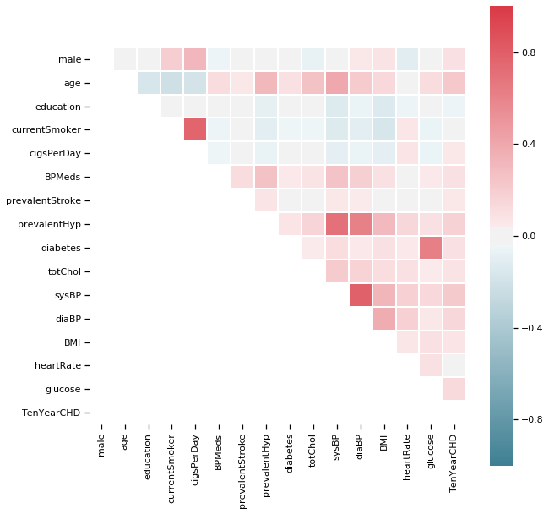
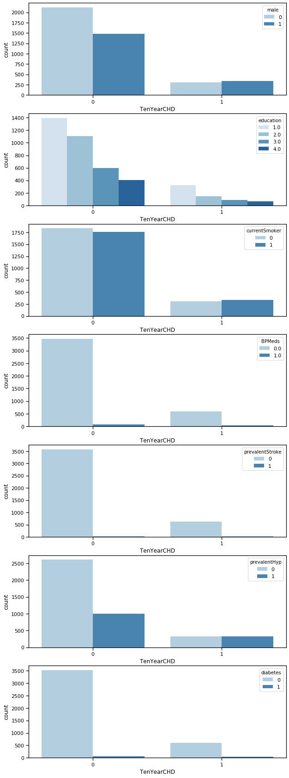
Research
Data Exploration
Correlations and Categorical Data Trends:
Notes:
In examining the dataset and in looking at the various correlations between features and our target feature (i.e. developing CHD), the strongest correlations with our target feature were age, systolic and diastolic blood pressure, and prevalence of hypertension. These results are as expected based on data and knowledge that is currently already well-known. Typically, people who are older have time to develop CHD, and factors such as high blood pressure (that is, high systolic and diastolic blood pressure) are also sought out as risk factors. Surprisingly, factors such as higher cholesterol levels, being on blood pressure medication and smoking were not associated with developing CHD over ten years. However, this may be due to the pattern of the data and the fact that we are looking at correlations, which may not pick up non-linear patterns. There may also be other variables at play which may affect the data that were also not accounted for or explored.
In looking closer at the categorical features, the feature that has the most distinct variation between cases of CHD and cases of no CHD is hypertension prevalence. We can see that if one were to develop CHD, the frequency at which someone has hypertension is increased, as opposed to when one doesn't have CHD, in which case the frequency at which they don't have hypertension is higher than having hypertension.

Slide 6
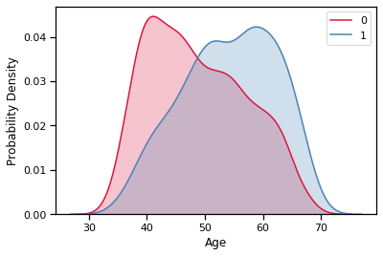
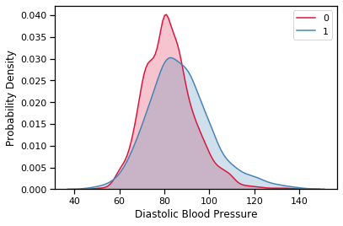
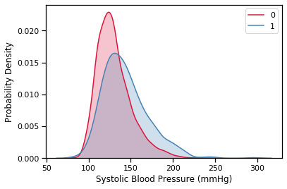
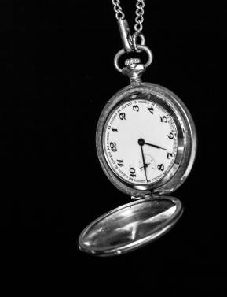


Research
Data Exploration
Numerical Data Trends:
Notes:
Furthermore, in looking at the numerical features, we can see that the data for CHD and non-CHD cases splits off a bit for three of our features. The probability of having CHD is higher than not having CHD once certain thresholds are reached. Specifically, we can see that the probability of someone having CHD is higher than not having CHD once reaching the age of 50 years and getting older; along with having a diastolic blood pressure above approximately 90 mmHg and a systolic blood pressure above approximately 150 mmHg.

Slide 7
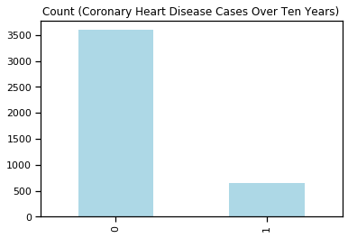
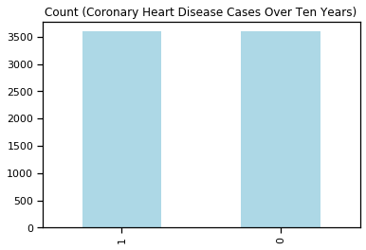
Research
Data Preparation
The following steps were taken to prepare our data for our models:
1. For numerical data, replace missing values with the median, and standardize the data.
2. For categorical data, replace missing values with the most frequent value and use one-hot encoding to encode the data.
3. Created a second data set to balance the underrepresented class (i.e. having CHD)
4. Split the data into training and testing data for both a balanced and unbalanced version of our dataset.
Notes:
Overall, throughout our data exploration, the following was observed:
- There were missing values for various attributes including: Education, Cigarettes Smoked per Day, On Blood Pressure Medication or Not, Total Cholesterol, BMI, Heart Rate, and Glucose Levels
- The data for numerical attributes was slightly skewed and on different scales
- The data for categorical attributes was encoded using a couple of different scaling methods (ex. Education on a scale of 1 through 4, implying a ranking; and a scale of 1 or 0 for hypertension prevalence)
- In examining the target feature, the dataset was highly unbalanced, with 15.19% of the data set representing those who have developed cardiac heart disease and 84.81% representing those who don't have cardiac heart disease
So, the following steps were applied to transform the data and to prepare it for our models:
- For numerical features, the missing values were replaced with their median values, while for the categorical features, missing values were replaced with the most frequent value
- Numerical features were scaled and standardized using Standard Scalar method
- For categorical features, all features were one-hot encoded to ensure a consistent scaling throughout the data set
- With regards to the unbalanced classes for our target features (i.e. whether or not somebody has coronary heart disease), a second dataset was created, in which class 1 (having CHD) was oversampled in order to create a dataset in which the classes are balanced. Throughout the project, both the unbalanced and balanced dataset were used and compared through each model that was tested in order to see the effect in the results for accuracy, precision and recall

Slide 8
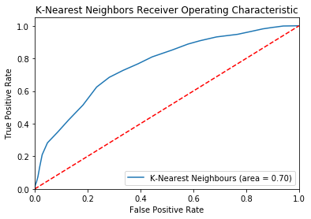
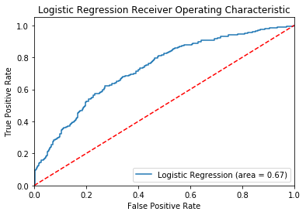
Research
Model Selection
The following models were explored and tested for accuracy in predicting CHD:
1. K-Nearest Neighbours
2. Logistic Regression
 | Precision | Recall | F1-score
0 | 0.73 | 0.67 | 0.70
1 | 0.67 | 0.73 | 0.69
 | Precision | Recall | F1-score
0 | 0.69 | 0.66 | 0.68
1 | 0.65 | 0.67 | 0.66
Notes:
Overall, in examining the predictions for each model and for both the balanced and unbalaned datasets, results were more promising in examining the balanced dataset class. That is, in the dataset in which the underrepresented class was randomly oversampled so that there were equal training samples for both classes in our target feature ('Ten Year CHD'). The reason being that recall scores, or the ability to accurately detect all of the positive instances of CHD, suffered in the unbalanced dataset. However, while in the balanced dataset, recall was improved very much, precision and recall for class 0 (not having CHD) went down. Though, in this project, we want to be able to detect the positive instances of CHD so that those who are progressing towards developing the condition can be identified. Thus, going forward, the results demonstrated are for the balanced dataset only.
In examining the KNN model, the hyperparameters tuned were n_neighbours with the most optimal was 24, resulting with an overall accuracy score of 69% and precision and recall scores of 67% and 73%, respectively.
In examining the logistic regression model, the hyperparameter that was tuned was C with an optimal value of 0.8, resulting in an accuracy score of 67%, precision and recall scores for class CHD (i.e. 1) of 65% and 67%, respectively. Clearly these models are not strong and accurate enough, so we tested out models that could provide more promising results.

Slide 9
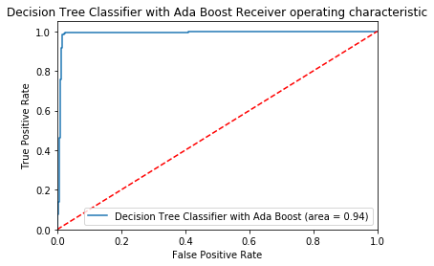
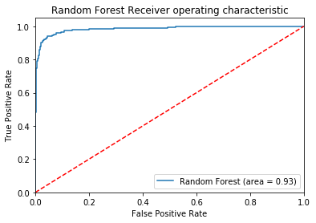
Research
Model Selection
3. Decision Tree Classification using AdaBoost
4. Random Forest
 | Precision | Recall | F1-score
0 | 0.99 | 0.88 | 0.93
1 | 0.88 | 0.99 | 0.93
 | Precision | Recall | F1-score
0 | 0.97 | 0.90 | 0.93
1 | 0.90 | 0.97 | 0.93
Notes:
The next model that was examined was decision tree classification. While the decision tree classfication model was also examined, the hyperparameters that were tuned and which produced the most accurate results in terms of precision and recall were max_features=15, max_depth=9, min_samples_split=200 and criterion='gini'. However, these results produced accuracy, precision and recall scores like seen in other models (about 68% accuracy for instance). In order to improve the model, AdaBoost was used, which produced much better results, with accuracy, precision and recall scores of 93%, 88% and 99%, respectively. Next, we wanted to see how this model stacks up with Random Forest to determine whether Random Forest Classification can result in better results.
In examining random forest, after tuning the model, the best hyperparameter values were found with the following values: n_estimators=200, max_features=5, max_depth=20, min_samples_split=15 and criterion='gini'. After running the model on the testing data, Random Forest produced results similar to that of AdaBoosted Decision Tree Classification, with accuracy, precision and recall scores of 93%, 90% and 97%.

Slide 10
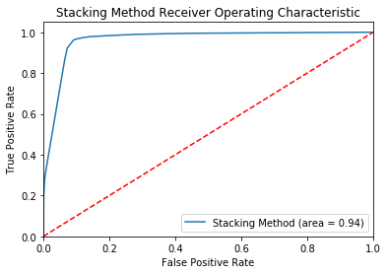
Research
Model Selection
6. Ensembles (Hard Voting and Stacking)
 | Precision | Recall | F1-score
0 | 0.98 | 0.95 | 0.97
1 | 0.95 | 0.98 | 0.96
Notes:
Lastly, we wanted to examine precision in identifying cases with coronary heart disease by combining our models to see whether there would be a higher predictive capacity. When we attempted hard voting, accuracy in training and testing was 84.8% and 79.4% respectively. To see whether stacking could overall result in more accurate predictions. Overall, it was in fact the strongest predictor in achieving an accuracy of 97%, precision of 95% and recall of 98%.

Slide 11

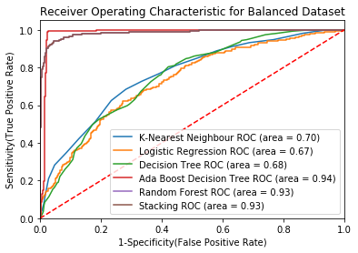
Research
Comparison of Models
The top performing models with the highest ROC scores are:
Ada Boosted Decision Tree (area=0.94)
Random Forest (area= 0.93)
Stacking (area= 0.93)
Notes:
In comparing each model and their ROC curves, we can clearly see that the best models were the model utilizing Stacking, AdaBoost Decision Trees and Random Forest Classification.

Slide 12
Research
Comparison of Models
 |  | F1-score | Accuracy
K-Nearest Neighbour | No CHD | 0.70 | 69%
 | CHD | 0.69
Logistic Regression | No CHD | 0.68 | 67%
 | CHD | 0.66
Decision Tree Classification using AdaBoost | No CHD | 0.93 | 93%
 | CHD | 0.93
Random Forest | No CHD | 0.93 | 93%
 | CHD | 0.93
Stacking | No CHD | 0.97 | 97%
 | CHD | 0.96
Notes:
In comparing each model's f1 score, which represents a combination of both the recall and precision scores, we can see that the models with the highest f1 score include: the decision tree classification model using AdaBoost Decision Tree Classification, Random Forest and Stacking with f1 scores above 0.90. The same results were found when looking at overall accuracy scores.
Overall, we can see that in order to determine the accuracy with which our model would predict the development of coronary heart diseases over a 10 year span, it would be stacking model, which achieved f1 scores of 0.96 and 97% accuracy.

Slide 13

Conclusion
The following models produced the most accurate results:
AdaBoosted Decision Tree Classification with 93% accuracy and 0.93 f1 score
Random Forest with 93% accuracy and 0.93 f1 score
Stacking with 97% accuracy and 0.96 f1 score
Notes:
In the end, there is some capability to predict whether someone is on route to developing coronary heart disease based on their current health conditions and lifestyle. In our case, utilizing machine learning models, such as stacking our models which produced the most accurate results with 97% accuracy. But in the end, whether or not someone develops CHD is also partly in your hands and based on daily choices. So why not alter the course of your health in adapting healthy life habits?

